Slide 1

DEPARTMENT OF ELECTRONICS AND COMMUNICATION ENGINEERING
CMR TECHNICAL CAMPUS UGC AUTONOMOUS
KANDLAKOYA (V), MEDCHAL ROAD , HYDERABAD 501401
Major Project Presentation On
Implementation Of Railway Track Crack Detection System
PRESENTED BY :
BATCH NO: A5
J.VIJAY KUMAR
J.ANIL KUMAR
R.MOHAN BABU
K.BHASKAR.
Y.SUJITH
PROJECT GUIDE
D.SREEKANTH
Assistant professor
PROJECT COORDINATOR
DR.SUDHA ARAVIND
Associate professor
HEAD OF THE DEPARTMENT
Dr.G.SRIKANTH
Head of the department
(217R1A0426) (217R1A0427) (217R1A0437) (217R1A0430) (217R1A0464)

Slide 2
CONTENTS
Introduction
Importance of the Project
Advantages
Applications
Software and Hardware
Literature Survey
  Introduction
  History
Problem Formulation :
  Proposed solution.
  Existing solution.
References

Slide 3
INTRODUCTION
Railways are one of the most important and affordable modes of transportation in India, playing a key role compared to other transport systems. However, train accidents are a serious concern, often leading to more severe damage and loss of life compared to road accidents.
Because of this, improving railway safety is crucial. Indian Railways has one of the largest rail networks in the world, covering over 115,000 kilometers. However, it faces challenges in terms of safety and reliability, as it doesn't meet global standards.
One of the main issues is the cracks in the railway tracks, which are often missed because they are not detected and fixed on time. A recent study found that more than 25% of the railway tracks need replacement due to cracks. Checking these cracks manually is slow and requires skilled workers, making the process inefficient.
To address this, a system is being developed to automatically detect cracks in railway tracks using modern technology like IOT and sensors. The system will collect large amounts of data to find rail faults and alert the relevant authorities. It will use an ultrasonic sensor to detect cracks, and if a crack is found, the information will be sent to the control room via a SMS.

Slide 4
IMPORTANCE OF THE PROJECT
Railway accidents often lead to significant loss of life and damage to property. Many incidents happen due to human error and the inability to detect track problems in time. Advanced technology like the Railway Crack Detection System (RCDS) using ultra sonic sensors can continuously monitor the tracks for cracks and obstacles.
This system, powered by a ESP-32/ESP-8266 microcontroller, offers real-time detection and can alert authorities before accidents occur. It is an efficient, cost-effective, and scalable solution for ensuring the safety of passengers and reducing train mishaps in India. Implementing such technology could greatly improve railway safety and reliability.
The goal of the proposed system is to detect cracks in the tracks and prevent accidents. It can quickly identify cracks so that necessary actions can be taken right away. This system not only replaces manual inspections but also saves time and money, making the process faster and more accurate.
The system works by first starting a motor, which activates an ultrasonic or IR sensor to detect cracks in the tracks. The motor moves the system forward, and if a crack or obstacle is detected, the vehicle will stop immediately.

Slide 5
ADVANTAGES
Cost-effective: The ESP32 is an affordable microcontroller, making it ideal for large-scale deployment across railway tracks.
Real-time Monitoring: With built-in Wi-Fi and Bluetooth, the ESP32 enables real-time data transmission.
Low Power Consumption: The ESP32 consumes less power, which is a key advantage for systems deployed in remote locations where access to power may be limited.
Easy Integration with Sensors: The ESP32 can easily interface with various sensors (e.g., ultrasonic, IR sensors) to detect cracks..
Long-range Communication: The ESP32 supports communication over Wi-Fi and Bluetooth, enabling the transmission of alerts over long distances.
Automation and Early Warning: The system can be automated to alert authorities in real-time if cracks are detected, preventing accidents by providing early warnings.
Lightweight and Portable: The compact size of the ESP32 allows it to be easily installed along railway tracks without the need for large, complex infrastructure.

Slide 6
APPLICATIONS
Real-time Crack Detection and Alerts
Autonomous Track Monitoring Vehicles
Wireless Data Transmission
Low-Cost Detection System for Developing Region
Remote Monitoring via IoT
Automated Railway Track Surveillance Drones
Track Crack Detection Robots
Mobile Inspection Units
Energy-Efficient, Battery-Powered Track Sensors

Slide 7
SOFTWARE AND HARDWARE
SOFTWARE:
Arduino IDE (Integrated Development Environment) is a software platform used to program and develop applications for the Arduino microcontroller boards. Arduino is an opensource hardware and software platform used to build electronics projects, which is designed for makers, hobbyists, and professionals.
The Arduino IDE provides a simple and user-friendly interface to write, compile, and upload code to Arduino boards. It supports the C and C++ programming Languages, and also provides a range of libraries and functions that can be used to interface with various sensors, actuators, and other components.

Slide 8
HARDWARE
ESP32-Microcontroller
L293d Motor Driver
DC Motors
Ultra Sonic Sensor
Global Positioning System(GPS)
Global System For Mobile Communication(GSM)
Jumper wires
Rechargeable Batteries
Light Emitting Diode(LED)
Buzzer
Liquid Crystal Display

Slide 9
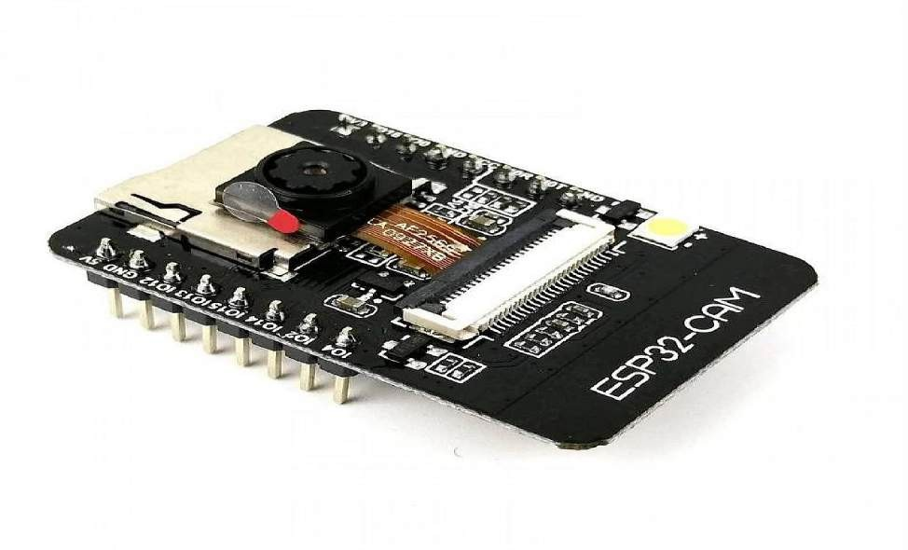
ESP-32 Microcontroller
A low-cost System on Chip (SoC) that is perfect for Internet of Things (IoT) applications that need connection is the ESP32 microcontroller. It is a flexible option for developing Internet of Things applications because it has Bluetooth and ESP8266, which is solely meant for Wi-Fi networking.
These include serial communication, high-resolution Wi-Fi capabilities. The ESP32 has more functions than the ADCs, and DACs.

Slide 10
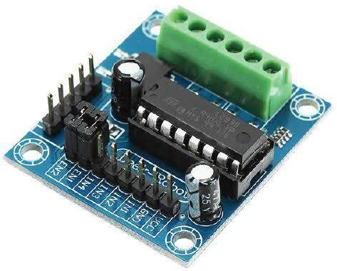
L293D Motor Driver
The L293d is popular 16-pin motor driver IC.As the name suggests it is mainly used to drive motors.A single L293D IC is capable of running to DC motor at the same time;also the direction of these two motors can be controlled independently

Slide 11
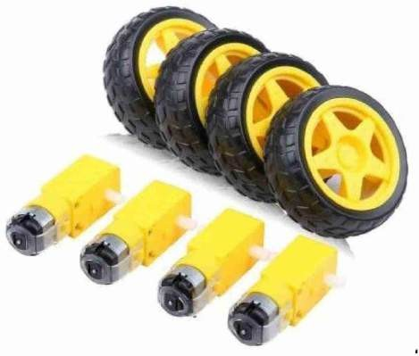
















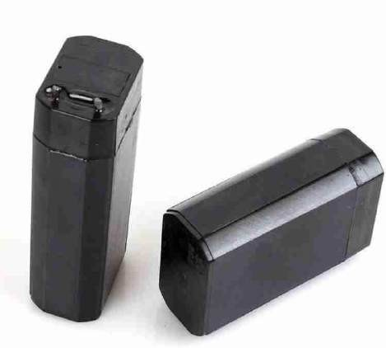


















DC BO Motors
Rechargeable Batteries

Slide 12
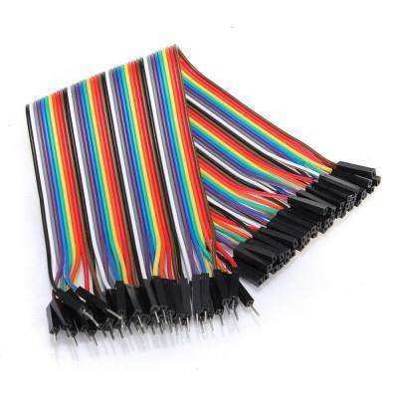
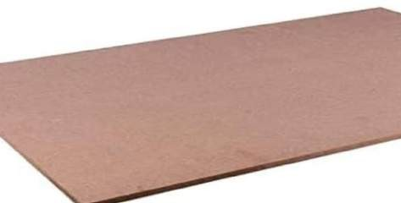
Jumper Wires
Jumper wires are small, flexible wires with connectors at ea temporary electrical connections on a breadboard or between They're commonly used in prototyping and experimenting w you to easily connect different parts without soldering.
Robot Chassis
The chassis is the structural component for the robot which contains the drivetrain and allows the robot to be mobile by using wheels, tank treads, or a
method. A chassis is sometimes referred to as the robot's frame.
ch end used to create
electronic components.
ith circuits, allowing
nother

Slide 13
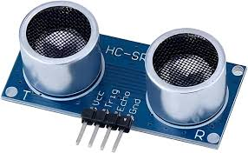
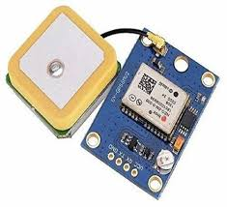
Ultra Sonic Sensor
An ultrasonic sensor is an instrument that measures the
separate to a question utilizing ultrasonic sound waves. An
ultrasonic sensor employment a transducer to send and get
ultrasonic beats that hand-off back data approximately an
object's vicinity
GPS Module
The Global Positioning System (GPS) is a satellite-based navigation system made up of at least 24 satellites. GPS works in any weather conditions, anywhere in the world,24 hours a day, with no subscription fees or setup charges.
GSM Module
GSM (Global System for Mobile Communications, originally Groupe Special Mobile). GSM is a TDMA based wireless network technology developed GSM phones make use of a SIM card to identify the user's account. The use of the SIM card allows GSM network users to quickly move their phone number from one GSM phone to another by simply moving the SIM card.

Slide 14
LITERATURE SURVEY
SI.No | Name of the author | Paper Title | International Journal/Conf erence | Month/Year | Description | Limitations
1. | Arun Kumar R, Vanishree K, Shweta K, Nandini C, Shweta G. | Railway Track Crack Detection | International Journal of Engineering Research & Technology (IJERT) | Sep/2020 | This project discusses a railway track crack detection using sensors and is a dynamic approach which combines the use of a GPS tracking system to send alert messages. | Arduino Microcontrollers used to control and coordinate the activities of this device.

Slide 15
SI. No | Name of the author | Paper Title | International Journal/Conf erence | Month/Year | Description | Limitations
2 | Rahul Singh, Leena Sharma, Vandana Singh, Vivek Kr | Automatic Railway Track Crack Detection System | International Research Journal of Engineering and Technology (IRJET) | May /2020 | The goal is to develop a railway crack detection system (RCDS) employing an ultrasonic sensor, the global system for mobile communications, the GPS and an Arduino-based module | whose implementation will provide a cost-effective method for detecting cracks in the tracks and thereby avoiding train derailments

Slide 16
SI. No | Name of the author | Paper Title | International Journal/Conf erence | Month/Year | Description | Limitations
3 | Anushree B.S, Priyasha Purkayastha, Anjali Girgire, Anjana K, Ruma Sinha. | Detection of Crack in Railway Track using Ultrasonic Sensors | International Journal of Scientific Development and Research (IJSDR) | May /2017 | The paper proposes a crack detection system, which detects the crack without human intervention and transmits the location of the fault to the authorized personnel via GSM. Using this technique, cracks can be detected both during the day and at night, revealing the precise location of the fault. | Arduino Uno kit is used as the main component which is being interfaced with others as dc driver, sensors and more. In this proposed system, two Arduino Uno kits are used as it has only one serial communication slot.

Slide 17
SI. No | Name of the author | Paper Title | International Journal/Conf erence | Month/Year | Description | Limitations
4 | Nilisha Patil1, Dipakkumar Shahare1, Shreya Hanwate1, Pranali Bagde1, Karuna Kamble1, Prof. Manoj Titre2. | Designing of Improved Monitoring System for Crack Detection on Railway Tracks | Third International Conference on Intelligent Communication Technologies and Virtual Mobile Networks (ICICV) | April /2021 | To overcome the issue of faults in tracks and identify the moving object or animal on the tracks, we learned an automated system based on a microcontroller and sensors. An autonomous robot with PIR and Ultrasonic sensors, coupled with GPS and GSM, is designed to provide real time alerts. | However, common limitations in crack detection systems for railway tracks may include challenges like limited detection accuracy in harsh weather conditions.

Slide 18
SI. No | Name of the author | Paper Title | International Journal/Conf erence | Month/Year | Description | Limitations
5 | Dinesh M1,AshwinK1,Balamurugan S1, Velmurugan C2 | AUTOMATC RAILWAY TRACK CRACK DETECTION SYSTEM USING MICROCONTROLLER & COMMUNICATION USING IoT | International Research Journal of Engineering and Technology (IRJET) | Mar/2024 | The system is designed to detect cracks on railway tracks, sending real-time alerts to relevant authorities for immediate action. A sensor-based system is employed to identify cracks, and data is transmitted using IoT for remote monitoring and maintenance | Sensor accuracy may be affected by environmental factors. High installation and maintenance costs. Reliance on consistent network connectivity for IoT communication

Slide 19
SI. No | Name of the author | Paper Title | International Journal/Conf erence | Month/Year | Descnription | Limitations
6 | Gaurav Bambal1 , Mohit Patil2 , Nikhil Khewale3 , Prof. G. A. Thakur4 | Advanced Railway Accident Prevention and Track Fault Detection Module using Raspberry-PI | International Journal for Research in Applied Science & Engineering Technology (IJRASET) | Jul/2023 | the development of a system to enhance railway safety. It uses a Raspberry Pi-based module to detect faults in railway tracks and prevent accidents by sending alerts to authorities. The system leverages sensors to monitor track conditions and can detect cracks, misalignment, and other issues that may cause derailment | The system's efficiency depends on sensor accuracy and environmental conditions. Limited range for real-time monitoring. Power and connectivity issues in remote areas may effect performance.

Slide 20
SI. No | Name of the author | Paper Title | International Journal/Conf erence | Month/Year | Description | Limitations
7 | N. L. Bhojwani, A.S. Ansari, S. S. Jirge, M. B. Baviskar, D. N. Pawar | RAILWAY TRACK – CRACK DETECTION SYSTEM BY USING ARDUINO MICROCONTROLLER | International Journal of Engineering Applied Sciences and Technology | Sep/2021 | The paper discusses a system designed to detect cracks in railway tracks using an Arduino microcontroller. The system uses sensors to detect cracks and immediately sends alerts to prevent accidents. The primary goal is to enhance railway safety by identifying track faults in real-time, thereby enabling quick maintenance and reducing the risk of derailments | Limited detection range due to sensor sensitivity. Dependent on external power supply, which could fail in remote areas. Environmental factors like weather and debris may affect sensor accuracy. May not detect very small cracks effectively.

Slide 21
SI. No | Name of the author | Paper Title | International Journal/Conf erence | Month/Year | Description | Limitations
8 | Prof. Najma Siddiqui1 , Prof. Akil Ahmed1 , Tejas Thakre2 , Sujyot Jibhe2 , Yogesh Karnake2 , Samir Sheikh2 , Yash Sangole2 , Sohelraza Sheikh2 | Development of Railway Track Crack Detection System using Arduino | International Journal of Scientific Research in Science and Technology | May/2023 | project aimed at improving railway safety by identifying cracks or defects in tracks. This system uses an Arduino microcontroller, which processes data from sensors to detect any breaks or abnormalities on the railway tracks. If a crack is found, the system sends a signal or alert to prevent accidents. | accuracy: Sensor precision may not detect very small cracks. Range: It may only cover limited track areas at a time. Power Dependence: The system relies on continuous power to function.

Slide 22
SI. No | Name of the author | Paper Title | International Journal/Conf erence | Month/Year | Description | Limitations
9 | Ramya C R1, Abhishek Y2, Karan Mahalatkar3, Stephen FS4 | Experimental Study of Railway Track Crack Detection Using Arduino | International Research Journal of Engineering and Technology (IRJET) | Aug/2023 | a system for detecting cracks in railway tracks using Arduino technology. The system utilizes sensors such as ultrasonic sensors, paired with Arduino microcontrollers, to monitor track conditions and detect cracks. The real-time data is processed and, upon detection of a crack, a warning signal is triggered, which can help prevent accidents. | Limited range: Ultrasonic sensors may not detect all types of cracks, especially minor or non-surface ones. Reliability in harsh conditions: Environmental factors like dust, water, and extreme temperatures could affect sensor accuracy. Scalability: Implementing this system on a large scale across extensive railway networks could be challenging. Power and maintenance

Slide 23
Existing Solution:
The existing system railway tracks are surveyed manually. LED (Light Emitting Diode) LDR (Light Dependent Resister) sensors cannot use on the slab of the tracks. Image processing input images are noisy system and it’s not getting accurate output.
This analysis is used to identify the crack in rail track under the bad whether condition which is not getting perfect output. The existing system is found delay in passing the information because still it uses telephonic communication which is not that fast and accurate.
System having LED and LDR sensor assembly, but the main disadvantage is that the LED and LDR must be placed opposite to each other and also the environment needs to be perfect to detect the track. To overcome this disadvantage, here proximity sensor is used, which will detect the crack accurately. The existing system is slow, tedious and time consuming.

Slide 24
Proposed Solution:
In proposed system crack in the tracks is detected by means of sensors and ESP-32 microcontroller, measuring distance for two railroad. In this project we use ultrasonic sensor to detect the crack. It uses to measure the distance between the two tracks.
If any crack are occurred in the track means longitude and latitude coordinates of the place are to be sent to the nearest station or control room and ultrasonic sensor measured the distance between the two track if there is any small variance found the message which contains coordinates of that particular place will be sent to the nearest station or control room with the help of GPS and GSM module.
This project is to be made in order to change the system of crack detection in railways which can be resulted out as not only cost-effective but also with good accuracy and time saving facility.

Slide 25
REFERENCES
[1]. V. Manoj, G. Bharadwaj, and N. R. P. A. Eswar, “Arduino Based Programmed Railway Track Crack Monitoring Vehicle”, International Journal of Engineering and Advanced Technology (IJEAT), ISSN: 2249-8958 (Online), Volume-8 Issue-6, August 2019.
[2].N. Benitta, JV. Belfya, J. Jancy, and Prof. J. ShriSaranyaa, “Railway Track Crack and Obstacle Detection using Arduino”, International Research Journal of Engineering and Technology
(IRJET), Volume: 06, Issue: 02, Feb 2019.
[3].Arun Kumar R,Vanishree K, Shweta K,Nandini C, Shweta G"Railway Track Crack Detection"International Journal of Engineering Research & Technology (IJERT)
ISSN: 2278-0181Published by,NCAIT – 2020.
www.ijert.org
[4]. N. L. Bhojwani, A. S. Ansari, S.S. Jirge, M. B. Baviskar, and D. N. Pawar, “Railway Track - Crack Detection System by using Arduino Microcontroller”, International Journal of Scientific Research and Engineering Development, Volume 3, Issues 2 Mar - Apr 2020.
[5]. C. Aniket, B. Shyamsundar, K. Soutrik, D. Koushik, and D. Susmita, “Automated Crack Detection of Railway Track”, IOSR Journal of Electrical and Electronics Engineering (IOSR-JEEE),
Volume 15, Issue 6 Ser. I (Nov. – Dec. 2020), PP 60-64.

Slide 26
[6]. N. L. Bhojwani, A.S. Ansari, S. S.Jirge, M. B.Baviskar, D. N.Pawar, "RAILWAY TRACK – CRACK DETECTION SYSTEM BY USING ARDUINO MICROCONTROLLER“ International Journal of Engineering Applied Sciences and Technology, 2021
Vol. 6, Issue 5, ISSN No. 2455-2143, Pages 288-292(http://www.ijeast.com)
[7]. Roushan Kumar Prasad, Dheeraj Kumar and Mr. Novel Kumar Sahu, “Study of Railway Track Crack Detection System”, International Journal for Research in Engineering Application &
Management (IJREAM), ISSN: 2454-9150, Vol-08, Issue-01, APR
2022.
[8] Gaurav Bambal1, Mohit Patil2, Nikhil Khewale3 Prof. G. A. Thakur4"Advanced Railway Accident Prevention and Track Fault Detection Module using Raspberry-PI "International Journal for Research in Applied Science & Engineering Technology (IJRASET) ISSN: 2321-9653; Volume 11 Issue VII Jul 2023- Available at www.ijraset.com
[9] Ramya C R1, Abhishek Y2, Karan Mahalatkar3, Stephen FS4"Experimental Study of Railway Track Crack Detection Using Arduino“ International Research Journal of Engineering and Technology (IRJET) e-ISSN: 2395-0056 Volume: 10 Issue: 08 | Aug 2023 .
www.irjet.net.
[10] Dinesh M1,AshwinK1,Balamurugan S1, Velmurugan C2"AUTOMATIC RAILWAY TRACK CRACK DETECTION SYSTEM USING MICROCONTROLLER & COMMUNICATION USING IoT "International Research Journal of Engineering and Technology (IRJET) e-ISSN: 2395-0056 volume:11 issue:03|Mar 2024.
www.irjet.net

Slide 27
THANK YOU.

